Slide 1
Data Management CT051-3-M
Topic 3 – Data Types

Slide 2
Topic & Structure of Lesson
What is Dataset
Types of Variables
Six Basic Ways to Identify Variables

Slide 3
What is Dataset?
Collection of data objects and their attributes
An attribute is a property or characteristic of an object
Examples: eye color of a person, temperature, etc.
Attribute is also known as variable, field, characteristic, parameter, factor, or feature
A collection of attributes describe an object
Object is also known as record, point, case, sample, entity, observation, or instance
Attributes
Objects

Slide 4
Types of Attributes
There are different types of attributes
Nominal
Examples: ID numbers, eye color, zip codes
Ordinal
Examples: rankings (e.g., taste of potato chips on a scale from 1-10), grades, height in {tall, medium, short}
Interval
Examples: calendar dates, temperatures in Celsius or Fahrenheit.
Ratio
Examples: temperature in Kelvin, length, time, counts
Notes:
Discrete/Categorical – Nominal and Ordinal
Continuous – Interval and Ratio

Slide 5
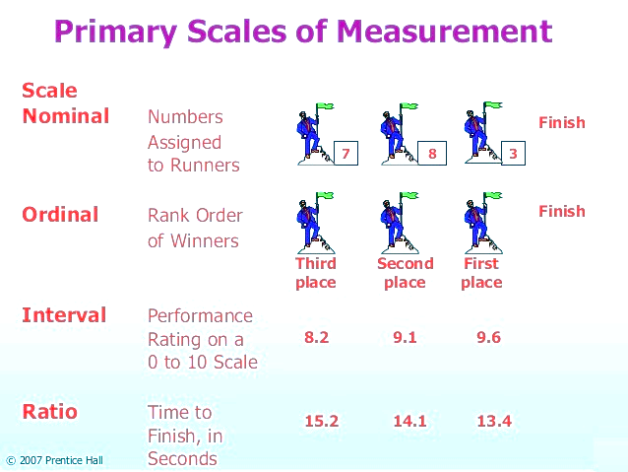
Exercise

Slide 6
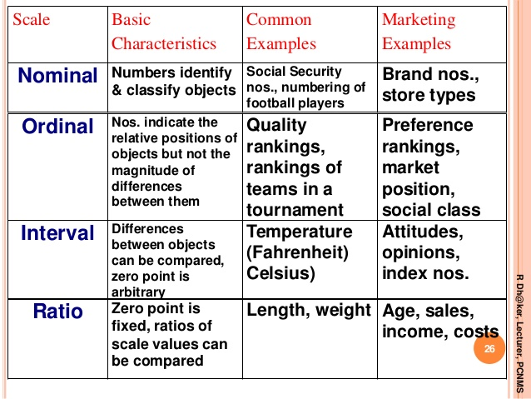
Exercise

Slide 7
Question 1 out of 5.
1. Identify the scale of measurement for the following: military title -- Lieutenant, Captain, Major.
nominal
ordinal
interval
ratio
Correct Answer: The scale is ordinal. There is an inherent ordering in that a Major is higher than a Captain, which is higher than a Lieutenant.

Slide 8
Question 2 out of 5.
2. Identify the scale of measurement for the following categorization of clothing: hat, shirt, shoes, pants
nominal
ordinal
interval
ratio
Correct Answer: Since clothes are categorized and have no inherent order, the scale is nominal

Slide 9
Question 3 out of 5.
3. Identify the scale of measurement for the following: heat measured in degrees centigrade.
nominal
ordinal
interval
ratio
Correct Answer: The scale is interval because there are equal intervals between temperatures but no true zero point.

Slide 10
Question 4 out of 5.
4. A score on a 5-point quiz measuring knowledge of algebra is an example of a(n)
nominal
ordinal
interval
ratio
Correct Answer: It is ordinal because higher scores are better than lower scores. However, there is no guarantee that the difference between, say, a 2 and a 3 represents the same difference in knowledge as the difference between a 4 and a 5.

Slide 11
Question 5 out of 5.
5. City of birth is an example of a(n)
nominal
ordinal
interval
ratio
Correct Answer: The city that someone was born in has no inherent order, thus can only be a nominal scale.
Notes:
Reference:
http://onlinestatbook.com/2/introduction/levels_of_measurement.html

Slide 12
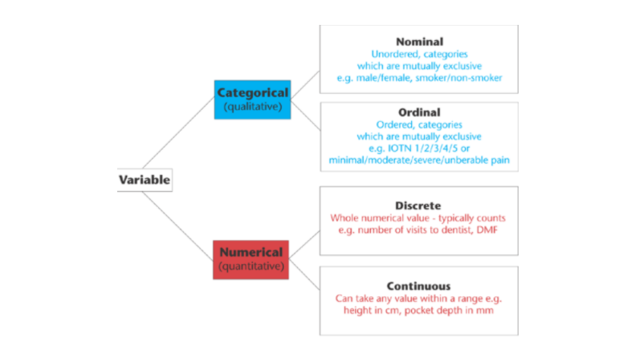

Slide 13
6 Basic Ways to Identify Variables
Independent Variables (Predictor Variables)
Dependent Variables (Criterion Variables)
Variables of Interest
Confounding (Control) Variables
Moderating Variables
Mediating Variables

Slide 14
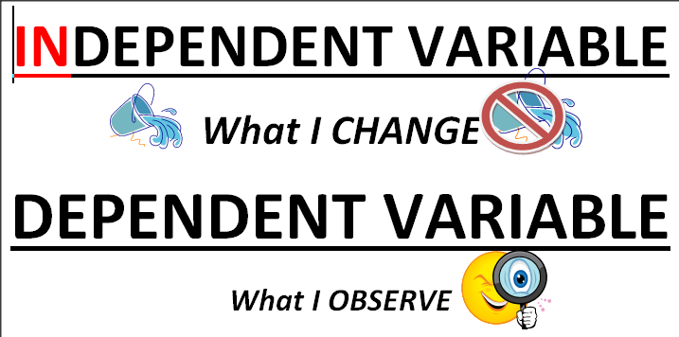
Independent & Dependent Variables

Slide 15
Independent & Dependent Variables
Independent Variable
[OR]
Input Variable
Dependent Variable
[OR]
Output Variable

Slide 16
6 Basic Ways to Identify Variables
Variables of Interest - To find the correlation analysis between two variables (dependent, independent variables)
Confounding (Control) variables - are variables that influence the dependent variable
Moderating variables - influence the strength of a relationship between two other variables
Mediating variables - explains the relationship between the two other variables

Slide 17
Mediator
A mediating variable explains the relation between the independent (predictor) and the dependent (criterion) variable. It explains how or why there is a relation between two variables.
A mediator can be a potential mechanism by which an independent variable can produce changes on a dependent variable.

Slide 18
Mediator
When you fully account for the effect of the mediator, the relation between independent and dependent variables may go away. For instance, imagine that you find a positive association between note-taking and performance on an exam. This association may be explained by number of hours studying, which would be the mediating variable.

Slide 19
Moderator
A moderator is a variable that affects the strength of the relation between the predictor and criterion variable. Moderators specify when a relation will hold. It can be qualitative (e.g., sex, race, class…) or quantitative (e.g., drug dosage or level of reward). Moderating variable are typically an interaction term in statistical models

Slide 20
Moderator
. For instance, imagine researchers are evaluating the effects of a new cholesterol drug. The researchers vary the participants in minutes of daily exercise (predictor/independent variable) and measure their cholesterol levels after 30 days (criterion/dependent variable).

Slide 21
Moderator
They find that at low drug doses, there is a small association between exercise and cholesterol levels, but at high drug doses, there is a huge association between exercise and cholesterol levels. Drug dosage moderates the association between exercise and cholesterol levels.

Slide 23
Question & Answer Session
Q & A

